Slide 1

Kisaan kalyan
Farmers form the backbone of the country.
The job most can’t handle.
OUR TEAM
RUTHVIK CHOWDARY
OM VINOD ALATAGI
Y V ANIRUDH
K S RAHUL

Slide 2
HOW IS THIS APP UNIQUE ?
It helps farmer know the prices of the crop even before he goes to the market.
It educates farmers about the crops that give good profit to them .
It makes the farmer aware of new government schemes in their local language.
It also links their kissan card to UPI.
All these feature help a farmer to earn good profits and prevent losses.

Slide 3
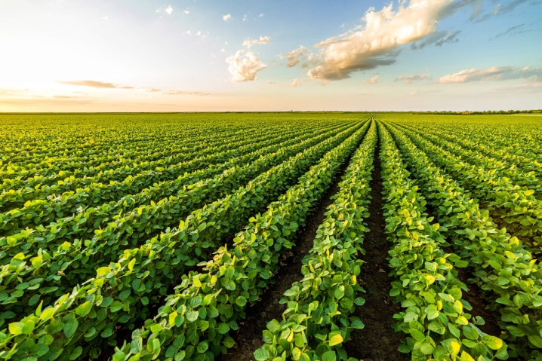
BENEFITS OF THIS APP
GIVES THE CURRENT MSP OF THE CROP.
PROVIDES THE FARMER WITH A FINANCIAL REPORT-KISAAN REPORT.
MAKES A FARMER AWARE OF NEW GOVERNMENT SCHEMES FOR FARMERS.
LINKS KISSAN CARD TO UPI.
GIVES US THE INFORMATION ABOUT THE PRICES OF THE CROP IN WHOLESALE MARKET.

Slide 4

CURRENT MSP OF THE CROP:
It allows the farmer to find out where he can sell his crops , to obtain max profit .
The transportation of the goods at low price with good service.
Allows the farmer to determine where to sell his crops in the wholesale market to attain maximum profits.
The MSP gets updated every time a farmer sells his crops in the farmers market.

Slide 5


KISAAN REPORT
Once the current MSP of the crops are uploaded to the app , the farmer can determine which crops were most profitable for him , along with his monthly and seasonal expenditure and income in the kisaan report.
It also gives in the report on the cost price of the necessary materials required for farming , like seeds , pesticides , fertilizers and equipment like tractors and sprinklers etc.

Slide 6

GOVERNMENT SCHEMES
The app also gives the farmers latest updates regarding farmers welfare released by the government in their preferred local language.
The Government has rolled out a number of new initiatives like Soil Health Card Scheme, Neem Coated Urea, Paramparagat Krishi Vikas Yojana (PKVY), Pradhan Mantri Krishi Sinchayee Yojana (PMKSY), National Agriculture Market (e-NAM) etc through kisan news.

Slide 7
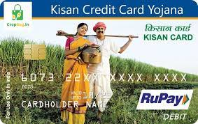
LINKING OF KISAAN CARD TO UPI
This app also allows a farmer to link his kissan card to UPI , in turn allowing him to access other financial apps.
This allows the farmer a direct link to his bank account , earnings , money spent on equipment like tractors and sprinklers.
Kisaan card (green card) provides adequate and timely credit to farmers to meet their cultivation needs.

Slide 8
WHY IS THIS NECESSARY?
Gives awareness of the benefits they are getting from the government and how to use it efficiently.
Farmers may find the current financial schemes difficult to comprehend, leading to mismanagement of finance which leads them to suffer losses.
Allows them to purchase farming equipment at low rate/prices.

